Slide 1

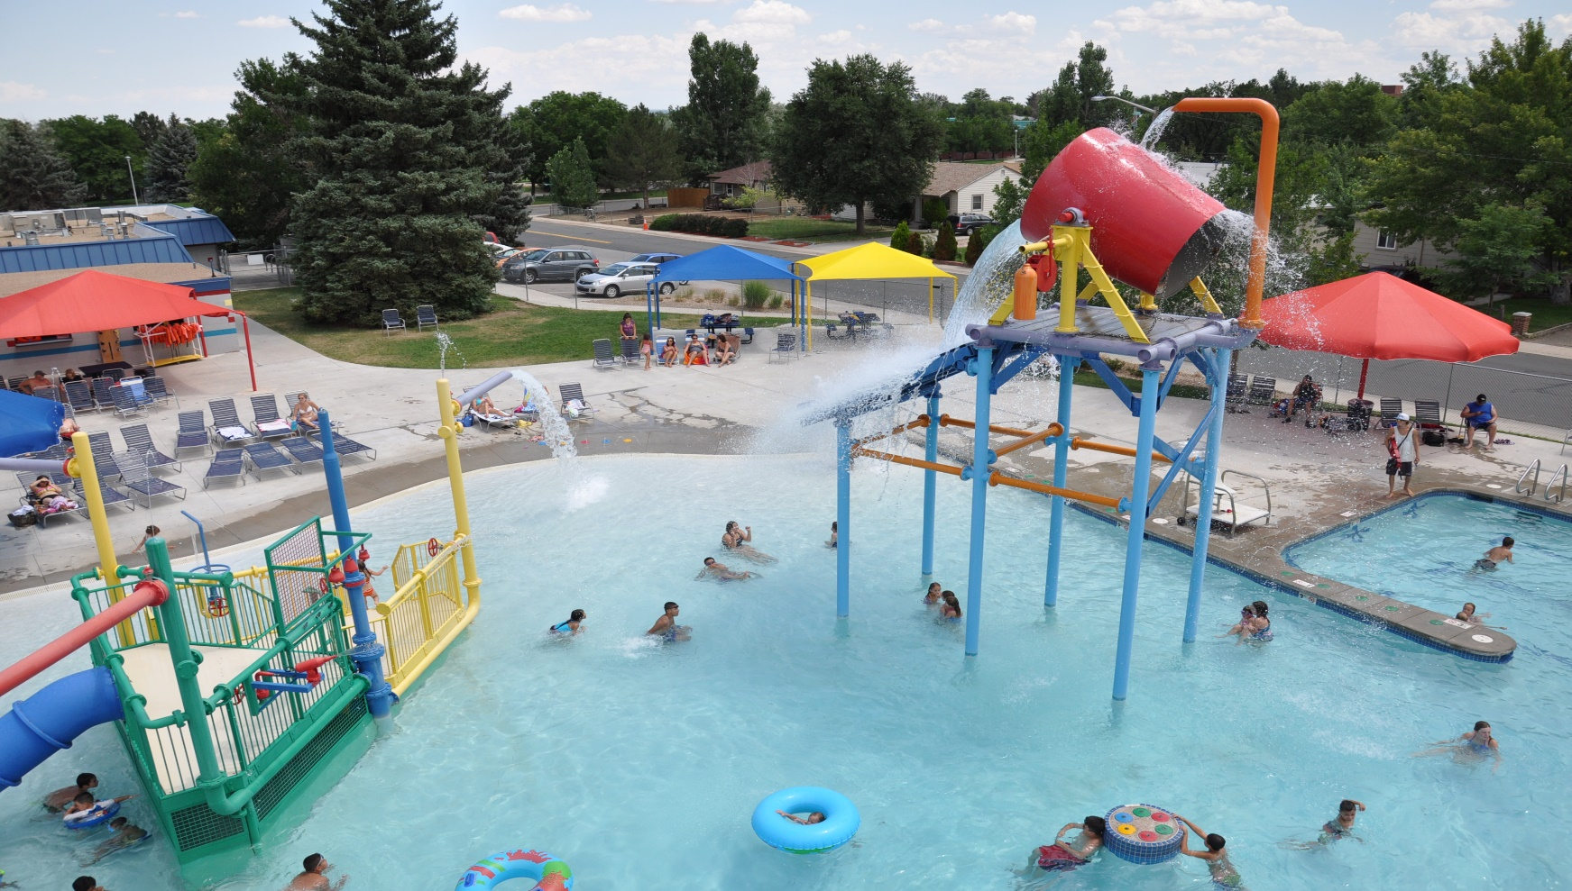
POOL SCHOOL 2022

Slide 2
Agenda
Recreational Water Illnesses
Inspections:
  Water Quality/Chemistry
  Pool System/Safety Equipment
  Signage
  Gates/Fences
  Chemicals
  Test Kits
  Circulation/Filtration
  Maintenance/Logs
Additional Info
REVIEW/VERBAL TEST

Slide 3
Recreational Water Illnesses

Slide 4
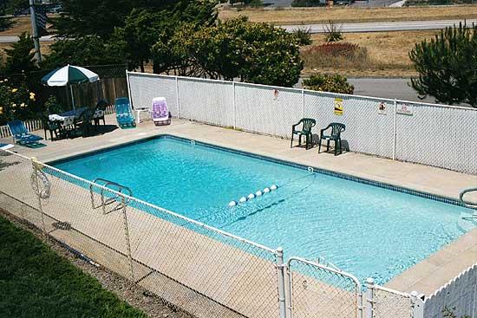
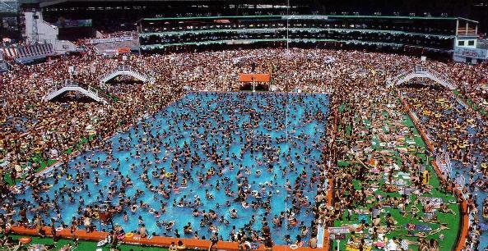
BIG or small…
...they all need the proper
care

Slide 5
Recreational Water Illnesses
Fecal Related Illnesses caused by:
  Cryptosporidium (Crypto)
  Giardia
  E. coli (O157:H7)
  Shigella
People who have had diarrhea should NOT swim for at LEAST 2 weeks after symptoms pass!
Notes:
When people infected with any of these diseases have a fecal release in the water and there is insufficient disinfectant to inactivate the pathogen, then swimmers who ingest water will swallow some of these germs and become ill.
Not all of these organisms are easily controlled by chlorine or other disinfectants. Crypto can remain active at normal disinfectant levels for several days. Protozoa are resistant to chlorination in swimming pool water.

Slide 6
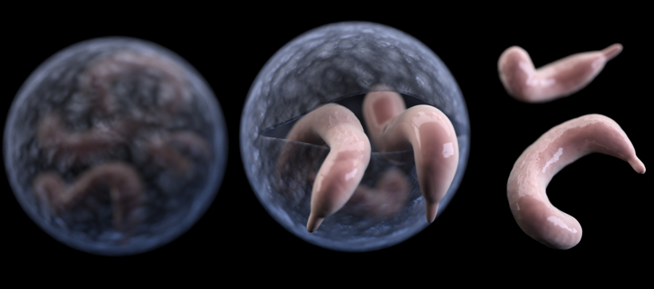
Cryptosporidium
A protozoan (Parasite)
Has two stages
Incubation period as long as 7 days before symptoms appear
People with compromised immune systems will have more severe reactions than healthy people
Illness lasts about 10 – 14 days
Symptoms include diarrhea, vomiting, fever, & abdominal cramps
No effective treatment
Notes:
First stage is related to gastroenteritis and a second stage (oocyst) is that which occurs outside of the body. The oocyst stage is the infective stage of the organism. The oocysts can be shed for one to two weeks after infection.
Patients who are immune deficient may have the disease for life with the severe watery diarrhea contributing to death.
There are many species of Cryptosporidium that infect animals, some of which also infect humans. The parasite is protected by an outer shell that allows it to survive outside the body for long periods of time and makes it very tolerant to chlorine disinfection.
While this parasite can be spread in several different ways, water (drinking water and recreational water) is the most common way to spread the parasite. Cryptosporidium is a leading cause of waterborne disease among humans in the United States.

Slide 7
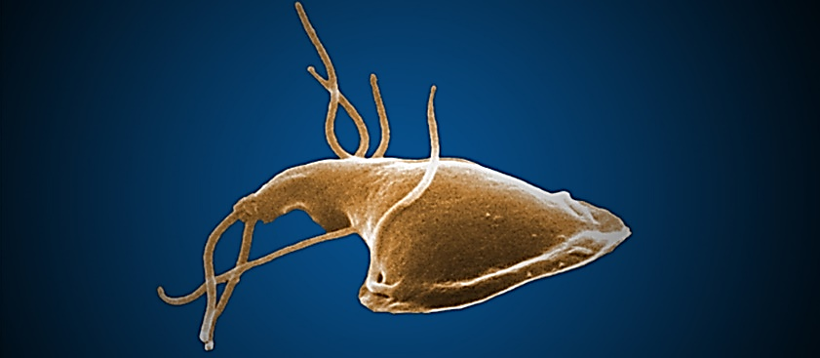
Giardia
A single-celled germ…Protozoa (Parasite) Most frequent cause of non-bacterial diarrhea in North America
Spread by contaminated food and water by direct person-to-person contact
Illness lasts 1 – 2 weeks
One of the most common causes of waterborne disease of humans in the United States
Notes:
Giardia: There are cases of chronic infections lasting months to years. Jee-ar-deea
Giardia is a microscopic parasite that causes the diarrheal illness known as giardiasis. Giardia (also known as Giardia intestinalis, Giardia lamblia, or Giardia duodenalis) is found on surfaces or in soil, food, or water that has been contaminated with feces (poop) from infected humans or animals. Giardia is protected by an outer shell that allows it to survive outside the body for long periods of time and makes it tolerant to chlorine disinfection. While the parasite can be spread in different ways, water (drinking water and recreational water) is the most common mode of transmission.

Slide 8
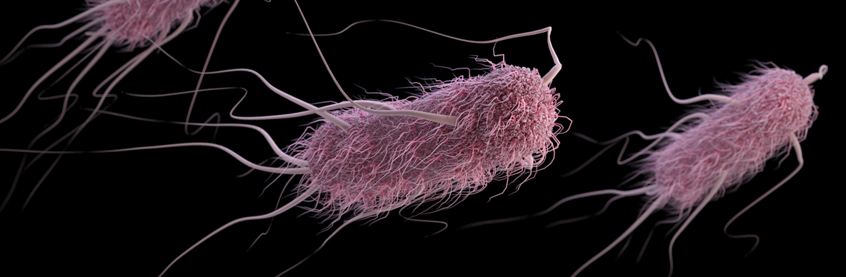
E. Coli (0157:H7)
Produces toxin that causes severe illness
Disinfectant quickly inactivates in water
Do NOT use pool/spa for up to 2 weeks after symptoms have passed
Notes:
Outbreaks due to poor hygiene and food contamination. This bacteria is easily controlled by chlorine at normal pool treatment levels. However, if an accidental fecal release occurs in a swimming pool, this organism will not be instantly eliminated in all cases. Time must be provided to allow for total disinfection.

Slide 9
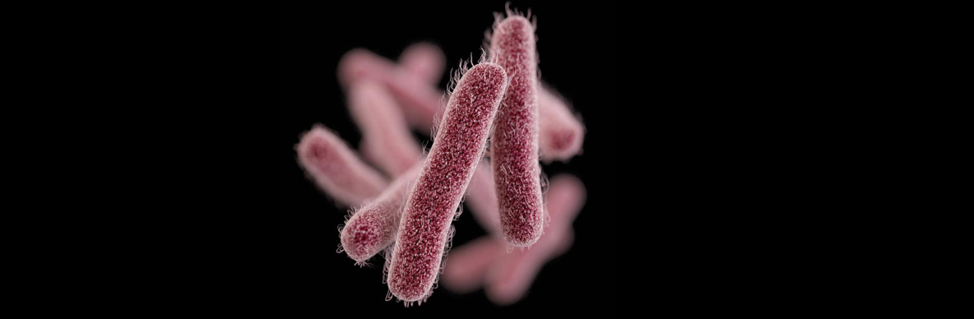
Shigella
Present in diarrhea stools of infected people while they are sick AND for up to 2 weeks after diarrhea ceases
Passed Fecal – oral route
Symptoms include diarrhea (often bloody), fever, and stomach cramps started 1 – 2 days after exposure
Lasts 5 – 7 days
Quickly inactivated by disinfectants
Notes:
Passed from stools or soiled fingers of one person to the mouth of another person. This happens due to poor hygiene and hand washing habits.

Slide 10
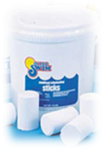
Pool Water Contaminants
The primary reason why pools are constantly treated with disinfectant is to keep people from getting sick due to contact or ingestion of contaminated of water
According to Texas Department of State Health Services (DSHS), in 2019 there were 1,244 reported cases of Cryptosporidium, 1,324 cases of E. Coli, and 4,024 cases of Shigella
*Giardia is not a reportable condition in Texas. However, the CDC reports that in 2019 in the southern states, 2,958 cases were reported.
All of these conditions are due to germs that can easily be killed by chlorine or other disinfectants
Notes:
This is the primary reason why public health departments such as Northeast Texas Public Health inspect pools. CDC issues reports on disease outbreaks every 2 years. Gastroenteritis is a stomach and intestinal disease that can range from a minor stomachache and diarrhea to death.

Slide 11
Other Illnesses
Pseudomonas – causes urinary tract infections, respiratory infections, dermatitis, & soft tissue infections
Legionellosis (Legionnaires)- very severe form of pneumonia. Thrives in poorly maintained spas and is transmitted by the mists produced by aeration or spray features
Plantar Warts – acquired by contact with deck/locker room floor surfaces
Athlete’s Foot – acquired by contact with deck/locker room floor surfaces.
Bromine Itch – contact dermatitis…rash/itchy skin
Notes:
Pseudomonas found in biofilm in the circulation system in spa/pool. Known for its resistance to antibiotics. Normal disinfectant levels sufficient for control. Bathers skin may become itchy and progress to a bumpy red rash-may also have pus-filled blisters. The areas covered by swimsuits may be worse because of longer contact with the skin. Occurs within a few days after contact. Usually clears up without any medical treatment.
Swimmer’s Ear- Another pseudomonas. Infection of the outer ear canal causing ear to become sensitive and inflamed. May have pus drain from ear. Common in children and young adults.
Legionanaires disease- Severe form is Legionnaire’s disease…which includes pneumonia. The second is Pontiac Fever, which causes flu-like symptoms. Normal disinfectant and frequent filter maintenance is important to controlling this disease. Do NOT have to be immersed in water to get this disease—it can be found in displays as well. Shower and Spray heads should be flushed on a regular basis with a disinfectant.

Slide 12
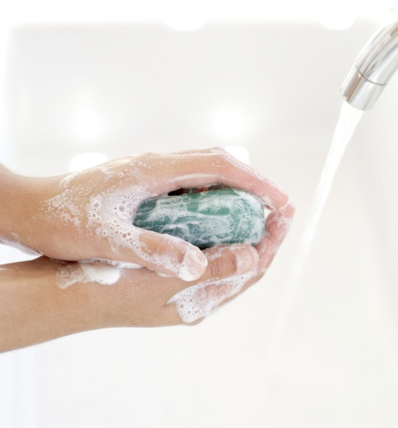
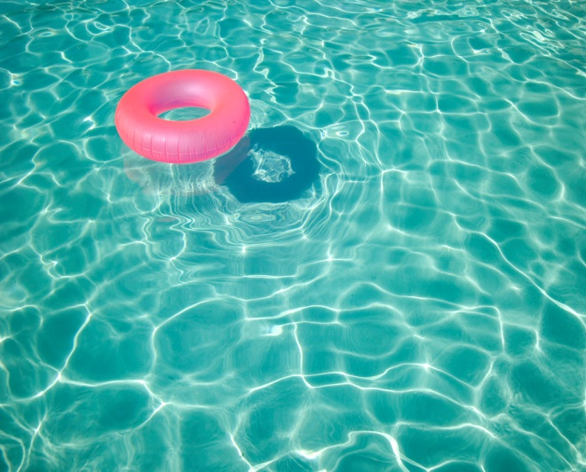
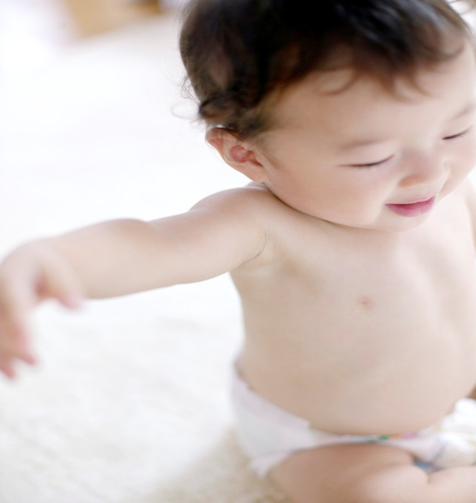
Sources of Contamination
Number 1 source of illness is from bathers’ buttocks.
Number 2 source of illness is from mucus, saliva and skin (considered non-enteric pathogenic organisms).
Notes:
Any person who enters the pool or spa will bring with them and release small quantities of fecal matter from their buttocks. It is very important to make bathers aware that they should avoid swimming if they recently have had diarrhea. Showering before swimming helps protect people against disease. Parents should also ensure that children take regular bathroom breaks and diapers should never be changed poolside-change inside restroom on approved equipment. WASH HANDS!!!

Slide 13
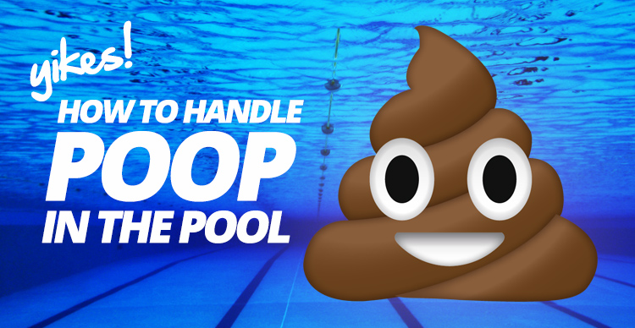

Slide 14


Accidental Fecal Response (AFR)
(Follow CDC guidance)
Direct all bathers to LEAVE the pool.
Manually remove as much of the material as possible and dispose in the sanitary facilities. Vacuuming is not recommended. Use a scoop or net.
Place all equipment used to remove the material into the pool during the following disinfection procedures.
Notes:
AFR = Accidental Fecal Releases.
If the filtration system services more than one body of water, all of the affected pools must be closed. The pool or pools must remain closed until the above conditions are met!

Slide 15

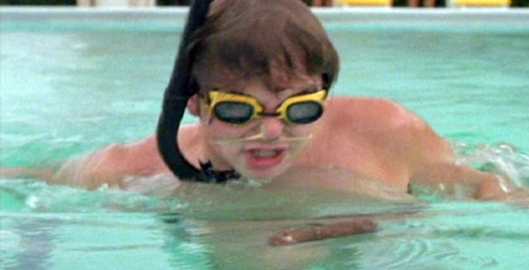
Accidental Fecal Response (AFR)
  Formed Stool
  Raise the free available chlorine level to 2 ppm and ensure the pH is between 7.2 – 7.5
  Maintain the chlorine concentration for at least 30 min. before re-opening the pool

Slide 16
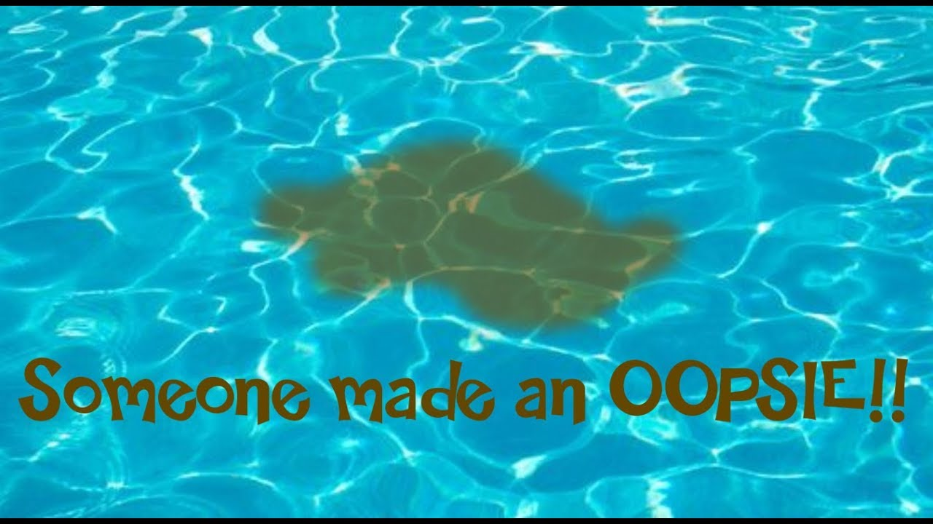
Accidental Fecal Response (AFR)
Diarrheal Discharge
  Raise free available chlorine level to 20 ppm
  Maintain pH between 7.2 – 7.5
  Maintain chlorine level for 12 hours
  Operate filtration system the entire disinfection time
  Backwash filter after the full disinfection time-direct to waste and not back into pool
  Return chlorine level to normal
  Log the event and record the date, AFR type, and the chlorine level at time of event CDC..RECOMMENDATION
Notes:
Also note the response time to the event, total time of disinfection and the time in which the pool was re-opened.

Slide 17
Blood & Vomit
Vomiting is a common event in swimming pools
Blood in pools does not survive long when diluted into properly chlorinated water
CDC recommends that if the full contents of the stomach is vomited to treat it the same as a formed stool incident
Notes:
Often the result of swallowing too much water. While it is probably not infectious, the CDC recommends that if the full contents of the stomach is vomited, the response should be the same as that used for a formed fecal incident.

Slide 18
Germ Inactivation Times (CT values)
CT = Concentration multiplied by Time. C is the (concentration) of free available chlorine in ppm. T (Time) is measured in min.)
CT value = ppm X minutes
Notes:
To effectively disinfect the pool after some form of pathogen is known to be present, it is required that the pathogen level be 99.9% inactivated.

Slide 19
Germ Inactivation Times (CT value) for chlorinated water
GERM |  | TIME
E. Coli 0157:H7 Hepatitis A | Bacterium Virus | Less than 1 min About 16 min
Giardia | Parasite | About 45 min
Crypto | Parasite | About 9,600 min or 6.7 days
Notes:
You will see on the next slide how the chlorine level will effect disinfection time.

Slide 20
Crypto Inactivation Time for Diarrheal Accident
Chlorine Levels (ppm) | Disinfection Time
1.0 | 6.7 days
10 | 16 hours
20 | 12 hours

Slide 21
Giardia Inactivation Time for Formed Stool Accident
Chlorine levels (ppm) | Disinfection Time
1.0 | 45 min
2.0 | 25 min
3.0 | 19 min

Slide 22
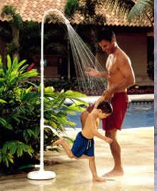

Prevention = Good Hygiene
Clean pool deck and walkways daily
Vacuum pool daily
Shower before entering/exiting pool
Do NOT enter pool for TWO WEEKS after having diarrhea.
Encourage bathers to report Accidental Fecal Releases to pool management ASAP
Swim diapers do NOT prevent leaks or contamination (Think of a tea bag)
Instruct parents to change diapers in restroom and not on pool deck or furniture

Slide 23
Tips for dealing with
Contaminated Surfaces
Wear rubber gloves
Remove excess contaminant material with paper towels or disposable wipes
Rinse all non-porous surfaces with hot water and then fully wet them with disinfectant
Wash porous surfaces with detergent, rinse and then flood with a disinfectant liquid
Deposit all towels, gloves, rags, and paper towels in a biohazard bag & dispose of properly
Never flush any contaminates into the pool or spa water or circulation pump
Wash away from pool

Slide 24


Encourage Parents to Make Babies wear Swimming Diapers
Don’t change the babies at the pool side
Change the babies’ diapers often
Place signs in a visible area informing parents of the risk of allowing children to swim with dirty diapers

Slide 25
Information
  www.cdc.gov/healthyswimming
  for Fecal Accident Response Recommendations for pool staff
          Any questions?
Notes:
CDC-Center for disease control
NSPF-Nation Swimming Pool Foundation

Slide 26
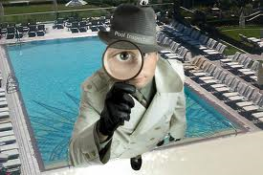
The Pool/Spa Inspection

Slide 27
Identify Your Pool
Class A Pool - Any pool used for accredited competitive events.
Class B Pool - Any pool used for public recreation and open to the general public with or without a fee. (City Pool, water parks)
Class C Pool - Any pool operated for and in conjunction with lodgings such a hotels, motels, apartments, condominiums, mobile homes parks, property owner’s associations, etc or a school, college or university while being operated for academic or continuing education classes or clubs or practice events. The use of such a pool would be open to occupants, members or students, etc. and their guests but not to the general public.
Class D Pool - A special purpose pool such as a wave pool or surface action pools, catch pools, leisure rivers, interactive play attractions, vortex pools, and other such pools used primarily for aquatic attractions.
Class F Pool - A splash pool with a maximum water depth of 36 in. at any point or a wading pool with a maximum depth of 2FT at any point.
Existing Pool / Spa - Existing prior to October 1, 1999.
New Pool / Spa - Constructed on or after October 1, 1999.
*Examples on the next slide*

Slide 28
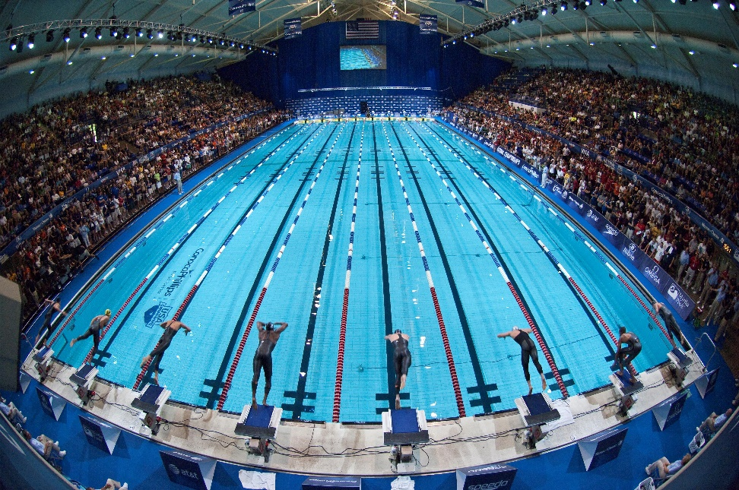
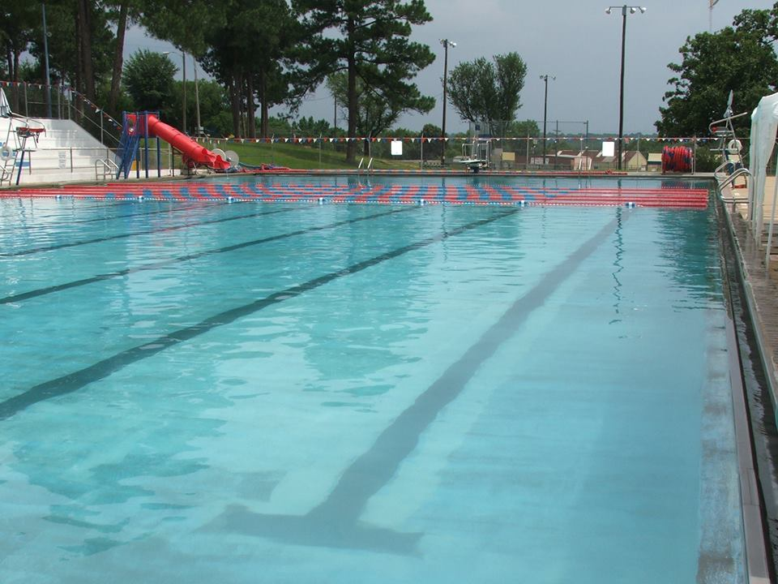
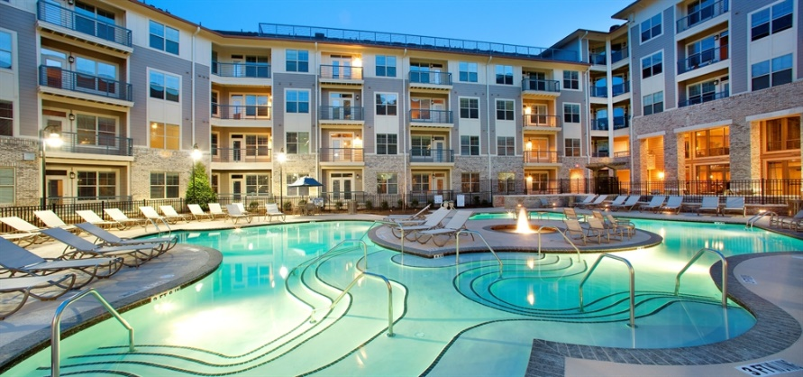
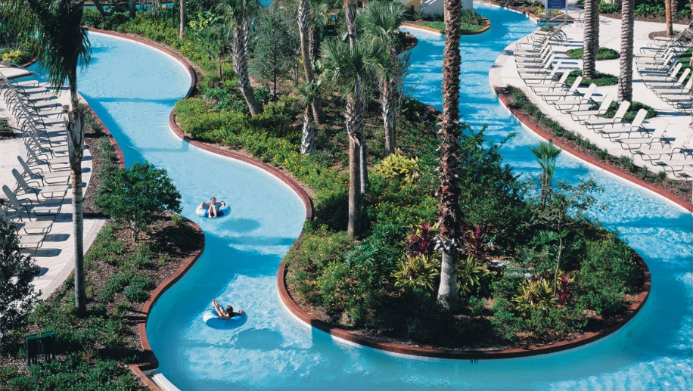
Class “A” Pools
Competitive Pools
Class “B” Pools
City Pools
Class “C” Pools
Apt., Hotels, HOA,
Class “D” Pools
Lazy Rivers, Vortex

Slide 29
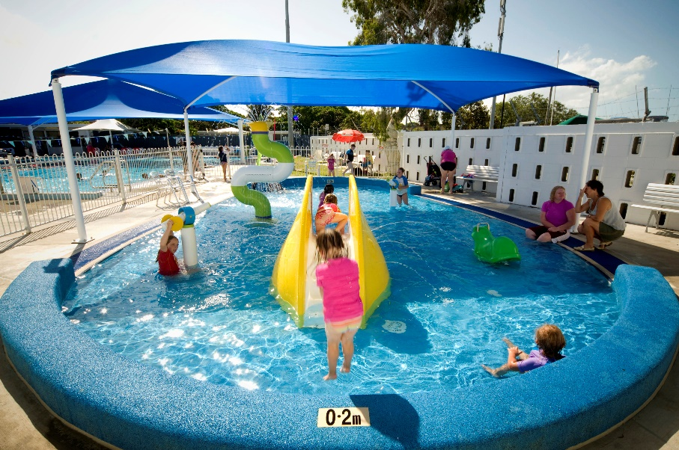
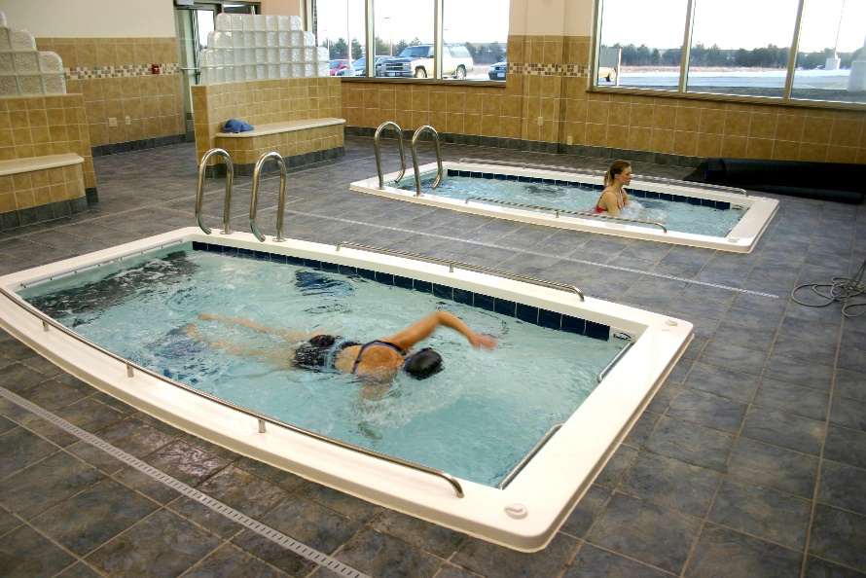
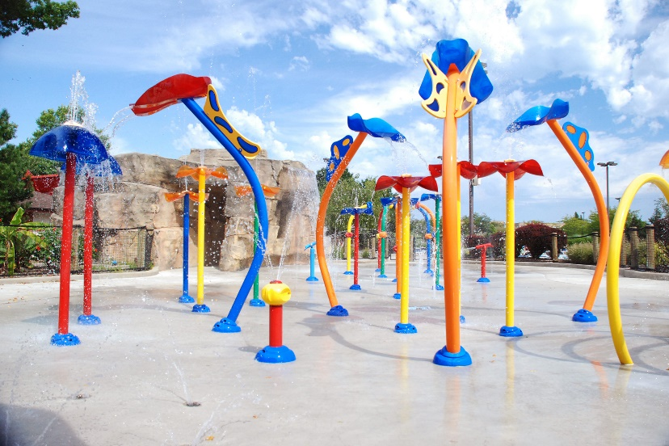
Class “T” Pools
Physical Therapy
Class “F” Pools
Wading Pool Kiddy Pool
P.I.W.F.
Public Interactive Water Feature

Slide 30
Pool Operators Should Know:
Volume of Pool in Gallons
Chemical Ranges
Type of Chemicals Used
Water Balance
How the Water Circulates
How to Clean Your Filter
Basic Trouble Shooting
Notes:
There are some basics that we need to be familiar with
These are the topics we will be covering today.

Slide 31
Sanitation
Swimming pool sanitation is the process of ensuring healthy conditions in swimming pools.
Proper sanitation is needed to maintain the visual clarity of water and to prevent the transmission of infectious waterborne diseases.

Slide 32
Disinfection
Is accomplished when the transmission of infections between persons or from the water is kept to a minimum.
Is the process of destroying microorganisms that might cause human disease. Pathogens include bacteria, fungi, viruses, & protozoan parasites.
Is affected by the pH of the water, temperature, environmental wastes, and bather contamination.
As the level of wastes and contamination increases, the proper level of disinfection becomes harder to maintain.

Slide 33
Oxidation
Oxidation refers to the reaction of a substance in the presence of oxygen. Iron rust is a common example of destructive oxidation, as iron is transformed to iron oxide, or rust, in the presence of oxygen. For swimming pools, the role of oxidation is critical to sanitizing pool water.
In the process of oxidation in pool water, chlorine or other oxidizers gain an electron while contaminants lose an electron, rendering them useless. In short, oxidation takes potentially dangerous contaminants in the water and reduces them to harmless molecules, making the pool safe for swimming.

Slide 34
Common Areas of Contamination From Bathers:
Hands may have ½ to 5
million germs shed in
a single washing
38, 000 germs with
clearing of nose
Area covered by swim trunks has an
Excessive high number of germs &
Organic matter to shed if not
Bathed prior to entering pool.
Perspiration: An active
swimmer contributes
2 pints/hour
Notes:
Boils and Infections are a source of contamination and a source of highly infective disease organisms.
100 million to 1 billion germs come from 1 gram of saliva from the mouth.
When perspiration, urine and other nitrogen-containing compounds are introduced into the water, they react chemically with chlorine to produce combined chlorine. Combined chlorine is much less effective as a disinfectant than hypochlorous acid. A high level of combined chlorine is usually noted by a strong chlorine odor and is measured by testing the water.

Slide 35


Slide 36
Water Quality/Chemistry
When choosing a disinfectant consider:
Water Temperature
Bathing loads
Indoor or Outdoor Pool
Type of facility (pool, spa, therapy, water park)
Chemical storage and safety concerns
Supervision & maintenance concerns
Codes & regulations

Slide 37
Water Quality/Chemistry
(Pools)
Free chlorine (FC) is the active available disinfectant in the water. (Range: 1.0 - 8.0 ppm… Ideal: 2.0 - 3.0 ppm)
Combined chlorine (CC) is the result of FC reacting with ammonia or organic nitrogen compounds. (Min and Ideal: none Max: 0.4 ppm)
    CC is also called “chloramines”
    Formed via urine, sweat, & environment
    Creates the Chlorine smell in indoor facilities
*Measured 2-3 times per day, unless automatic system is used…then once per day*
Notes:
The amount of chlorine necessary to destroy germs or other impurities in the water is called the CHLORINE DEMAND. Chlorine demand increases with direct sunlight, higher water temperatures, heavy swimmer loads and contaminants that carried into the water. When the demand becomes too great, the free available chlorine is consumed and the disinfection process stops. At this point, either inorganic or organic chloramines have taken over and will need to be destroyed by adding chorine to the water until the reading in 10 times the combined chlorine. At this breakpoint, the ammonia in the water will be converted to nitrogen gas and water. Superchlorination, also will kill and oxidize any organic matter in the water. Do not allow for use of the pool or spa until levels reach 3.0 ppm or lower. For organic chloramines, water replacement, ozone treatment, water clarifiers or filtration enhancers are some options for removal.
The amount of chlorine necessary to destroy germs or other impurities in the water is called the CHLORINE DEMAND. Chlorine demand increases with direct sunlight, higher water temperatures, heavy swimmer loads and contaminants that carried into the water. When the demand becomes too great, the free available chlorine is consumed and the disinfection process stops. At this point, combined chlorine has taken over and will need to be destroyed by adding chorine to the water until the reading in 10 times the combined chlorine. At this breakpoint, the ammonia in the water will be converted to nitrogen gas and water. Superchlorination, also will kill and oxidize any organic matter in the water. Do not allow for use of the pool or spa until levels reach 3.0 ppm or lower.

Slide 38
Water Quality/Chemistry
(Pools)
pH is the term used to refer to the degree of activity of an acid or base (alkali) in the water. It is the most important chemical factor to be maintained in swimming pools. pH is measured on a scale from O to 14 with 7 being neutral. (Range: 7.0 – 7.8 Ideal: 7.2 – 7.6)
*More on this in a bit*
Cyanuric acid is used in outdoor swimming pools to lower the rate of photochemical reduction of chlorine, hypochlorous acid, and hypochlorite ion. That’s just a fancy way of saying it protects your pool’s chlorine from the effects of sunlight. The cyanuric acid extends the life of the chlorine by shielding it from ultraviolet rays. (Min: none Ideal: 30 – 50 ppm Max: 100 ppm)
*Measured once per week*
Notes:
Cyanuric acid is used in swimming pools to lower the rate of photochemical reduction of chlorine, hypochlorous acid, and hypochlorite ion. That’s just a fancy way of saying it protects your pool’s chlorine from the effects of sunlight.
Once you add chlorine to your pool, the big yellow thing in the sky goes to work burning off the chlorine through chemical reactions, seriously decreasing the power of the chlorine in your pool water. In fact, the sun can eat up to 1 ppm (part per million) of chlorine every hour if it’s not protected.
The cyanuric acid extends the life of the chlorine by shielding it from ultraviolet rays. Without it, the ultraviolet rays from the sun would break apart the chlorite ions, allowing the chlorine to just evaporate into thin air. It literally stabilizes the ion, making it resistant to any chemical changes.
When you add cyanuric acid to your pool, it binds to the free chlorine floating around to form a compound that’s stable in sunlight. The reaction can also go the other way and release free chlorine.
As free chlorine gets used up, the cyanuric acid provides a backup of cleaning potential that’s safe from the sun. The free chlorine in your pool will then be available for sanitizing far longer than it would be without using stabilizer.
But just like wishing for immortality from a magical genie, there’s a catch. The increased lifespan of chlorine means it’s weaker than it was before.
Longer life = Decreased cleaning power
In other words, it takes stabilized chlorine longer to kill bacteria than it takes chlorine without stabilizer. As you can see, cyanuric acid is very useful but can be a double-edged sword, both increasing chlorine’s lifespan and decreasing its disinfecting power in your pool.
Why You Need Cyanuric Acid In Your Pool
Studies show that direct sunlight can decrease chlorine levels by up to 90 percent in two hours. And not just that, but the summer heat that warms your water can also be a breeding ground for bacteria, which also uses up chlorine more quickly.
What? That’s crazy, right? I know you’re starting to see dollar signs dance in your eyes, thinking of all of the chlorine you’re going to have to buy to keep up with the sun’s depleting effects. Not to worry, though, this is where cyanuric acid comes in to save the day.
Imagine cyanuric acid as a protective forcefield around the chlorine in your pool. It shields these cleaning molecules from ultraviolet destruction, extending the lifespan of the chlorine you just added. It’s a miracle worker in many ways, allowing you to manage your pool’s chemistry with minimal effort.
Cyanuric acid is a very important part of a good pool care regimen. It keeps your chlorine levels in check all summer long, without you having to constantly add more and more chlorine to your pool.

Slide 39
Water Quality/Chemistry
(Spas)
Free chlorine (FC) is the active available disinfectant in the water. (Range: 2.0 - 8.0 ppm… Ideal: 2.0 - 3.0 ppm)
Combined chlorine (CC) is the result of FC reacting with ammonia or organic nitrogen compounds. (Min and Ideal: none Max: 0.4 ppm)
    CC is also called “chloramines”
    Formed via urine, sweat, & environment
    Creates the Chlorine smell in indoor facilities
*Measured 2-3 times per day, unless automatic system is used…then once per day*
Notes:
The amount of chlorine necessary to destroy germs or other impurities in the water is called the CHLORINE DEMAND. Chlorine demand increases with direct sunlight, higher water temperatures, heavy swimmer loads and contaminants that carried into the water. When the demand becomes too great, the free available chlorine is consumed and the disinfection process stops. At this point, either inorganic or organic chloramines have taken over and will need to be destroyed by adding chorine to the water until the reading in 10 times the combined chlorine. At this breakpoint, the ammonia in the water will be converted to nitrogen gas and water. Superchlorination, also will kill and oxidize any organic matter in the water. Do not allow for use of the pool or spa until levels reach 3.0 ppm or lower. For organic chloramines, water replacement, ozone treatment, water clarifiers or filtration enhancers are some options for removal.
The amount of chlorine necessary to destroy germs or other impurities in the water is called the CHLORINE DEMAND. Chlorine demand increases with direct sunlight, higher water temperatures, heavy swimmer loads and contaminants that carried into the water. When the demand becomes too great, the free available chlorine is consumed and the disinfection process stops. At this point, combined chlorine has taken over and will need to be destroyed by adding chorine to the water until the reading in 10 times the combined chlorine. At this breakpoint, the ammonia in the water will be converted to nitrogen gas and water. Superchlorination, also will kill and oxidize any organic matter in the water. Do not allow for use of the pool or spa until levels reach 3.0 ppm or lower.

Slide 40
Water Quality/Chemistry
(Spas)
pH is the term used to refer to the degree of activity of an acid or base (alkali) in the water. It is the most important chemical factor to be maintained in swimming pools. pH is measured on a scale from O to 14 with 7 being neutral. (Range: 7.0 – 7.8 Ideal: 7.2 – 7.6)
*More on this in a bit*
Cyanuric acid is used in outdoor swimming pools to lower the rate of photochemical reduction of chlorine, hypochlorous acid, and hypochlorite ion. That’s just a fancy way of saying it protects your pool’s chlorine from the effects of sunlight. The cyanuric acid extends the life of the chlorine by shielding it from ultraviolet rays. (Min: none Ideal: 30 – 50 ppm Max: 100 ppm)
*Measured once per week*
Notes:
Cyanuric acid is used in swimming pools to lower the rate of photochemical reduction of chlorine, hypochlorous acid, and hypochlorite ion. That’s just a fancy way of saying it protects your pool’s chlorine from the effects of sunlight.
Once you add chlorine to your pool, the big yellow thing in the sky goes to work burning off the chlorine through chemical reactions, seriously decreasing the power of the chlorine in your pool water. In fact, the sun can eat up to 1 ppm (part per million) of chlorine every hour if it’s not protected.
The cyanuric acid extends the life of the chlorine by shielding it from ultraviolet rays. Without it, the ultraviolet rays from the sun would break apart the chlorite ions, allowing the chlorine to just evaporate into thin air. It literally stabilizes the ion, making it resistant to any chemical changes.
When you add cyanuric acid to your pool, it binds to the free chlorine floating around to form a compound that’s stable in sunlight. The reaction can also go the other way and release free chlorine.
As free chlorine gets used up, the cyanuric acid provides a backup of cleaning potential that’s safe from the sun. The free chlorine in your pool will then be available for sanitizing far longer than it would be without using stabilizer.
But just like wishing for immortality from a magical genie, there’s a catch. The increased lifespan of chlorine means it’s weaker than it was before.
Longer life = Decreased cleaning power
In other words, it takes stabilized chlorine longer to kill bacteria than it takes chlorine without stabilizer. As you can see, cyanuric acid is very useful but can be a double-edged sword, both increasing chlorine’s lifespan and decreasing its disinfecting power in your pool.
Why You Need Cyanuric Acid In Your Pool
Studies show that direct sunlight can decrease chlorine levels by up to 90 percent in two hours. And not just that, but the summer heat that warms your water can also be a breeding ground for bacteria, which also uses up chlorine more quickly.
What? That’s crazy, right? I know you’re starting to see dollar signs dance in your eyes, thinking of all of the chlorine you’re going to have to buy to keep up with the sun’s depleting effects. Not to worry, though, this is where cyanuric acid comes in to save the day.
Imagine cyanuric acid as a protective forcefield around the chlorine in your pool. It shields these cleaning molecules from ultraviolet destruction, extending the lifespan of the chlorine you just added. It’s a miracle worker in many ways, allowing you to manage your pool’s chemistry with minimal effort.
Cyanuric acid is a very important part of a good pool care regimen. It keeps your chlorine levels in check all summer long, without you having to constantly add more and more chlorine to your pool.

Slide 41
Water Quality/Chemistry
pH is the measure of the active acid or base in the pool/spa.
0 1 2 3 4 5 6 7.0 7.2- 7.6 7.8 8 9 10 11 12 13 14
Corrosive Water: Scaling Water::
Etching of pool/spa surface Clogged filters
Corrosion of metals Clogged heater elements
Staining of surface walls Reduced circulation
Chlorine loss Cloudy water
Wrinkles in vinyl liners Chlorine inefficiency
Eye/skin irritation Eye/skin irritation
Corrosive Ideal Scale
Low pH High pH
Notes:
Factors affecting the pH of pool or spa water includes: swimmer waste, disinfectants, source water, air-borne debris, water balance chemicals, aeration, evaporation. The recommended pH of pool/spa water is 7.2-7.6, similar to tears from the human eye which is about 7.5. The method of control for pH is to maintain the alkalinity. To lower pH, muriatic acid or sodium bisulfate may be added. To increase pH add sodium carbonate, aka soda ash, sodium hydroxide, or sodium bicarbonate.

Slide 42
Water Quality/Chemistry
Breakpoint Chlorination (BPC): The conversion of combined chlorine compounds to nitrogen gas is called breakpoint chlorination or BPC.
BPC = 10 x (TC-FC)
Or
BPC = 10 x CC – FC
* Example on next slide *
Notes:
To achieve BPC, additional free chlorine must be added to the water. The amount of new chlorine is a calculation and must be 10 times the amount of combined chlorine. For example.

Slide 43
BPC Example
A 55,000 gallon pool with FC=1.5ppm; TC=2.3ppm; How many ppm additional chlorine must be added to achieve breakpoint?
TC – FC = CC
2.3 – 1.5 = .8ppm
BPC = CC X 10
BPC = 10 x .8
BPC = 8.0 ppm
Original FC -1.5
BPC 6.5 ppm

Slide 44
Water Quality/Chemistry
Other required tests necessary for operation are:
Total Alkalinity
Calcium Hardness
* Performed every 30 days*
Notes:
Properly balanced water is necessary for the efficient use of treatment chemicals and protects pools from unnecessary but costly repairs. To keep the water in balance, 3 interrelated parameters must be maintained. They are alkalinity, hardness and pH.

Slide 45
Water Quality/Chemistry
Total Alkalinity: A measure of the buffering capacity of water, or its ability to resist a change in pH. It is a BUFFER.
Ideal alkalinity ranges from 80-100ppm for calcium, lithium or sodium hypochlorite.
Ideal alkalinity ranges from 100-120pm for sodium dichlor, trichlor, and chlorine gas.
Is like an anchor for keeping pH where it should be. Without proper buffering, the pH may swing dramatically from highs to lows.

Slide 46
Water Quality/Chemistry
Total Alkalinity:
Low total alkalinity: Not enough bicarbonate ions to provide buffer for pH-causes pH bounce, water with a green tint (if iron or copper is present)
High Total alkalinity: pH very difficult to change. Calcium carbonate suspended in water-cloudy effect; can be lowered with addition of muriatic acid or sodium bisulfate.
60ppm Ideal 180ppm
pH Bounce pH Lock
Etching of pool/spa surface Cloudy water
Staining of surface walls Rough pool/spa surfaces
Heater failure Clogged filters/heater elements Reduced circulation
Low Total Alkalinity
High Total Alkalinity
Notes:
Without proper buffering, the pH may swing dramatically from highs to lows. This is called pH bounce.

Slide 47
Water Quality/Chemistry
Calcium Hardness: the presence of minerals, particularly calcium and magnesium in water. (Naturally Present)
Too low = major contributor to foaming in spas/add calcium chloride
Too high = Cloudy water/partial drain with addition of new water.

Slide 48
Water Quality/Chemistry
Calcium Hardness:
Ideal level is 200 – 400 ppm
Min Ideal Max
150 ppm 200 to 400 ppm 1000 ppm pools 800 ppm-spas
Corrosive Water Scaling Water
Etching of pool/spa surface Rough pool/spa surfaces
Staining of surface walls Clogged filters/heater elements
Heater Failure Cloudy water/reduced circulation
Eye/Skin irritations
Low Calcium Hardness
High Calcium Hardness
Notes:
As the calcium hardness approaches 1000ppm, it is impossible to maintain water balance, pH, and total alkalinity in the proper ranges. As calcium hardness exceeds 500ppm, extreme care must be taken to maintain lower total alkalinity an pH levels to avoid scale, especially in hot water environments.

Slide 49
Water Clarity
Water clarity shall be sufficient such that an eight-inch black disk on the floor at the deepest part of the pool can be clearly and immediately seen by an observer on the water surface above the disk or by someone standing on the deck closest to the disk.

Slide 50
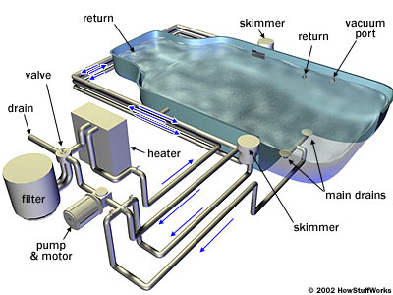
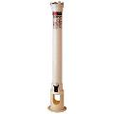
POOL SYSTEM
Multi-port
FEEDER

Slide 51
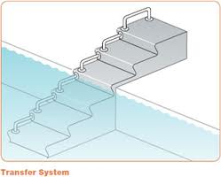
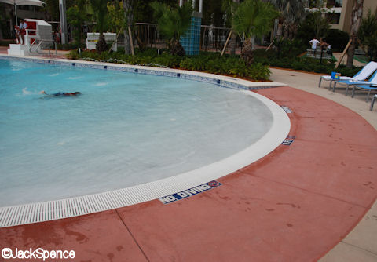
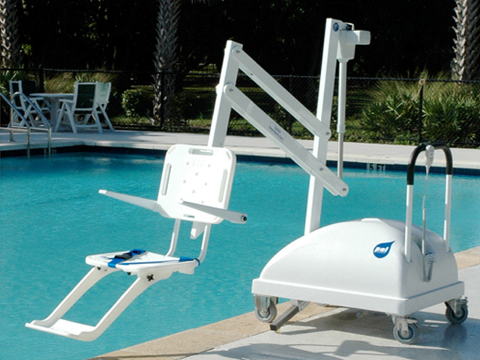
Americans with Disabilities Act
Was effective January 31, 2012
A.D.A. Phone # 1-800-514-0301
TRANSFER WALL
Zero Entry
CHAIR LIFT
Notes:
Please check with ADA.gov

Slide 52
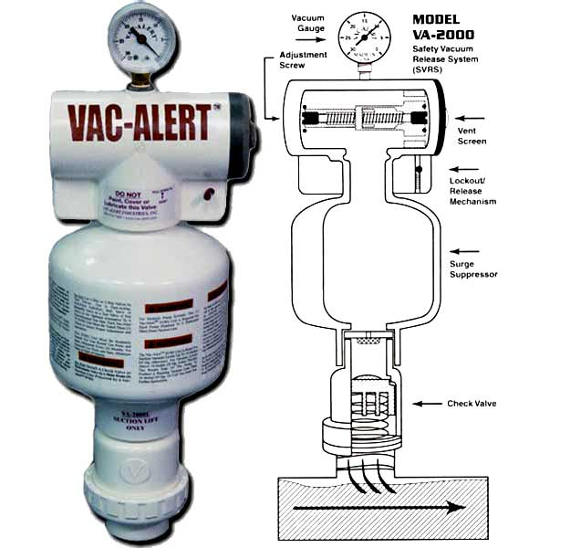
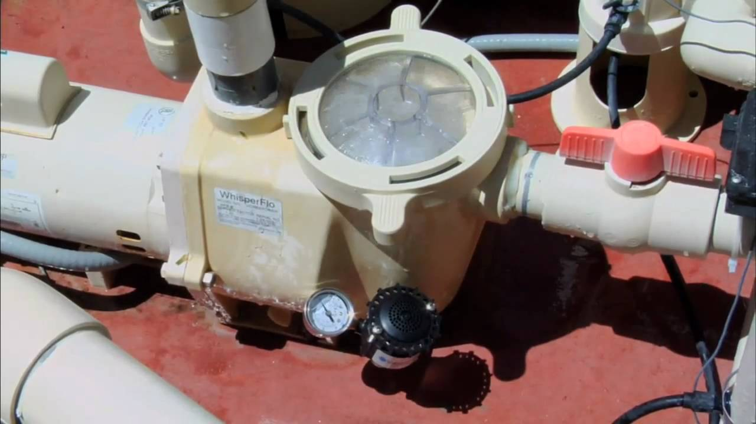
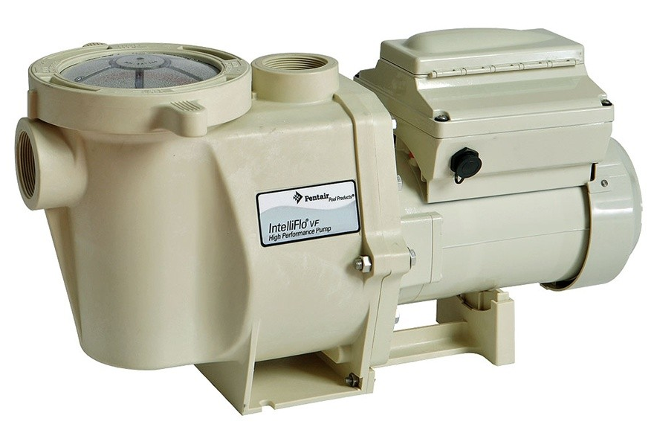
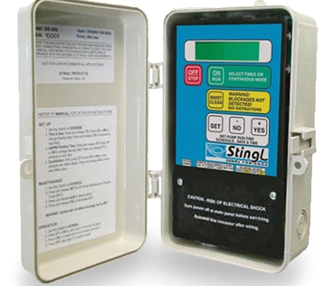
SVRS – Safety Vacuum Release System
APSS – Automatic Pump Shut-off System
VAC-ALERT
VACLESS SYSTEM
STINGL SWITCH
BUILT IN SVRD SYSTEM

Slide 53
Safety Vacuum Release System (SVRS) and Automatic Pump Shut-off System (APSS)
SVRS
System capable of providing vacuum release at a suction outlet in case of a high vacuum occurrence due to a suction outlet flow blockage. Methods include venting the suction line to atmosphere, turning off the circulation pump, or reversing the circulation flow.
APSS
A pump motor control or other device capable of turning off, stopping, or otherwise incapacitating a pump in response to a condition such as high vacuum, low flow, or low current that would indicate a suction entrapment event has occurred.

Slide 54
Safety Vacuum Release System (SVRS) and Automatic Pump Shut-off System (APSS)
Shall be operated, tested, and maintained according to manufacturer’s instructions. Testing and maintenance records or logs for the SVRS or APSS shall be maintained on-site for 2 years.
Pools and spas constructed prior to Jan 1, 2021 that have single points of suction (single submerged suction outlet) are required to install a SVRS and APSS.

Slide 55
Suction Outlet
A submerged fitting, fitting assembly, cover or grate, and related components that provide a localized low-pressure area for the transfer of water from a pool or spa.
A suction outlet system shall be designed to protect against suction entrapment, evisceration, and hair entanglement or entrapment hazards in accordance with ANSI/APSP-16, American National Standard for Suction Entrapment Avoidance in Swimming Pools, Wading Pools, Spas, Hot Tubs and Catch Basins.
Pools and spas constructed or renovated on or after the effective date of this subchapter shall not have a single fully submerged suction outlet.

Slide 56
Suction Outlet
Dual outlets and three or more outlets:
Pools and spas constructed or renovated on or after 1 January, 2021 shall have dual or three or more suction outlets that are designed, constructed, manufactured, and installed in accordance with ANSI/APSP/ICC. A suction outlet system shall be designed to protect against suction entrapment, evisceration, and hair entanglement or entrapment hazards in accordance with ANSI/APSP-16, American National Standard for Suction Entrapment Avoidance in Swimming Pools, Wading Pools, Spas, Hot Tubs and Catch Basins.
(1) The distance between dual VGBA-compliant suction outlets, as measured from center to center of the suction outlet cover or grate, shall be no less than three feet.
(2) The flow rate through a fitting, cover, or grate shall not exceed the approved flow rate for that fitting, cover, or grate when one suction fitting in a suction outlet system is blocked.
(3) No means of isolating suction outlets is permitted that could allow one suction outlet to serve as the sole source of water to a pump.
(4) A single pipe to a pump suction inlet that serves two or more suction outlets may have a valve to shut off the flow to the pump..

Slide 57
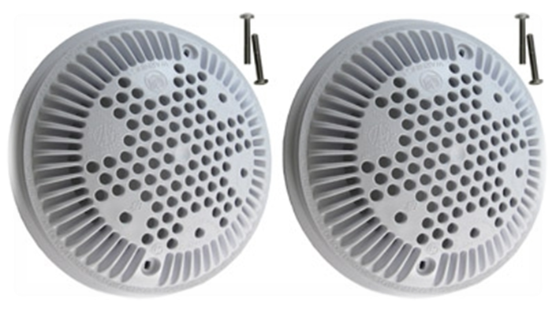
Suction Outlet Covers must be “VGB” Compliant
On December 19, 2007, the President signed into law the Virginia Graeme Baker Pool and Spa Safety Act. The Act specifies that on or before December 19, 2008, swimming pool and spa drain covers available for purchase in the United States must meet specific performance requirements.
This act supersedes the Texas Standards for Public Swimming Pools and Spas as well as the referenced 1996 standard ASME/ANSI A112.19.8M for pre-10/01/99 and post-10/01/99, local law, ordinance, or any national standard that conflicts with the law.
Notes:
ASME- American Society of Mechanical Engineers
ANSI- American National Standards Institute

Slide 58
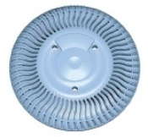
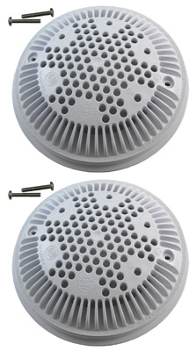
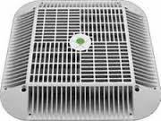
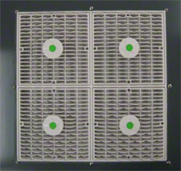
Examples of VGB Covers
Make sure you have the screws that go with them.
Need to have a replacement
Cover on site at all
Times.
Notes:
Remember there is a recall for single main drains go to http://www.cpsc.gov for more info.

Slide 59
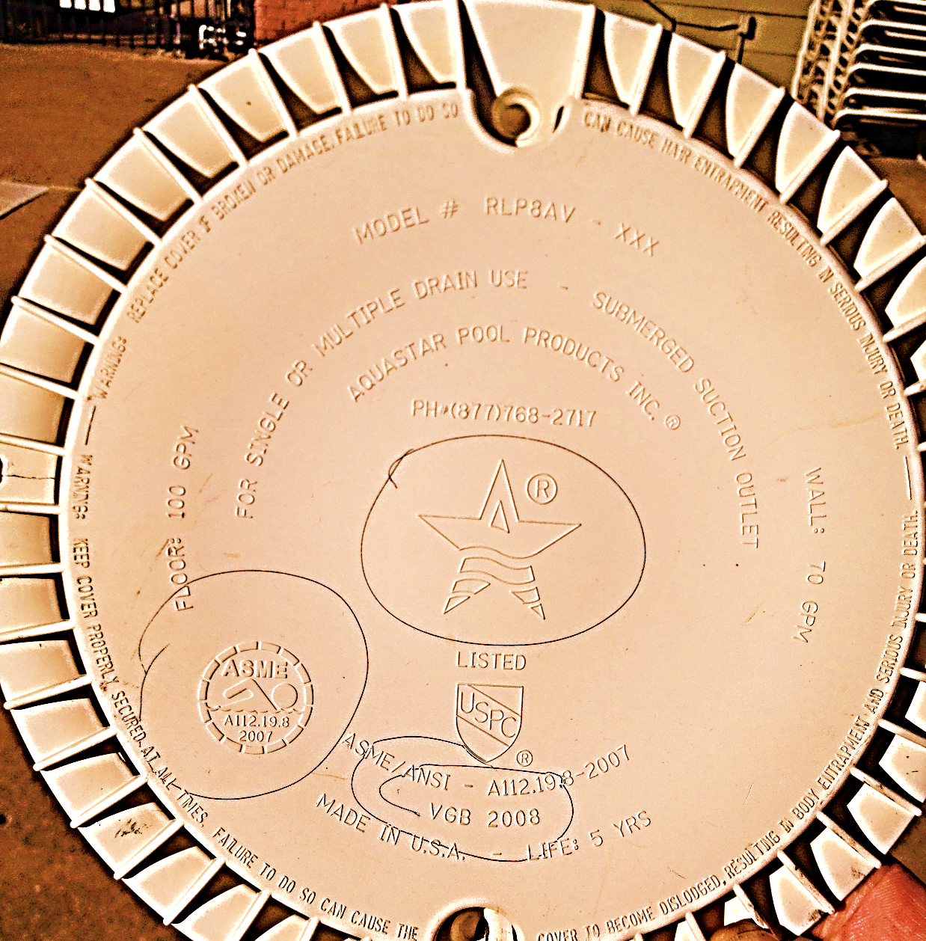

VGB Cover
The ASME standard requires covers to display:
American Society of Mechanical Engineers
VGB 2008
•Use—single or multiple
•Flow rate GPM
•Life or the number of years 3 or 5
•Wall and/or floor mount
•Manufacturer’s name (Aquastar)
•Model number
•Flow Rates and Single Drains

Slide 60

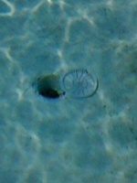
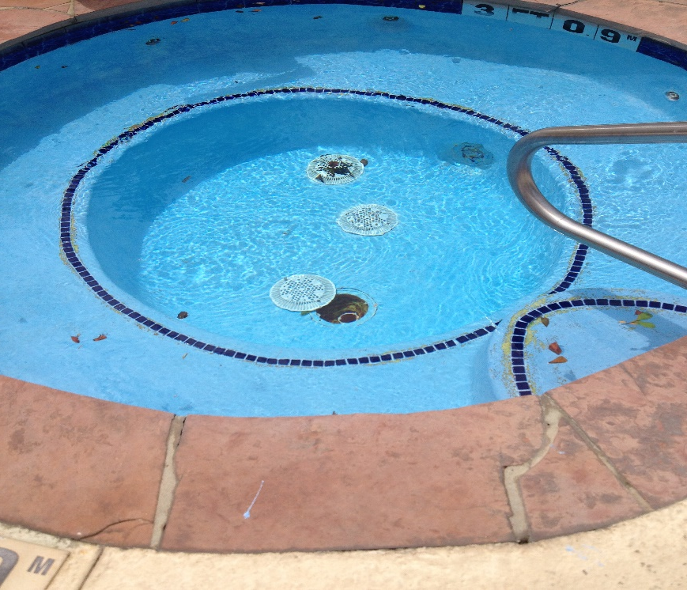


A Broken Main Drain Can Become an Entrapment Danger
Why is this bad, and what should you do next ?

Slide 61
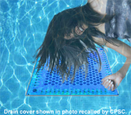
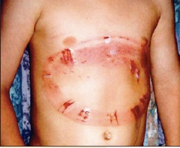
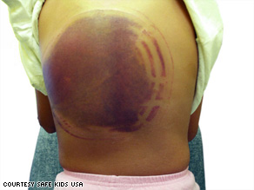
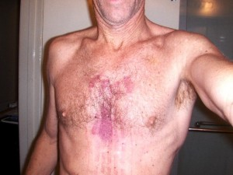
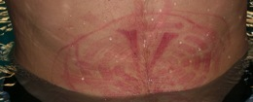
Drain Cover Accidents

Slide 62

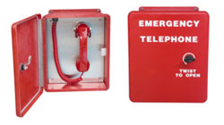
Emergency Summoning Device
A pool or spa shall have a minimum of one emergency telephone, emergency monitoring contact device, or alternative communication system that is capable of immediately summoning emergency services and that is readily accessible, within 200 feet of the water and is functioning at all times that the pool or spa is open for use.

Slide 63
Emergency Summoning Device
A fixed location telephone, emergency monitoring device, or alternative communication system shall be visible, have no obstruction to access, and have some method of identification that enables the telephone or other device or system to be easily identified by users.
A telephone shall be capable of making calls to 911 dispatch or emergency services.
An emergency monitoring contact device, when activated, shall directly connect to a 24-hour monitoring service, or directly to 911 dispatch or to emergency services.
A cell phone that is dedicated for use at the pool or spa, mounted in the pool or spa yard for public use and labeled as the emergency phone, may be used if the cell phone is activated by a service provider and is provided with a permanent power supply.
A sign shall be posted

Slide 64
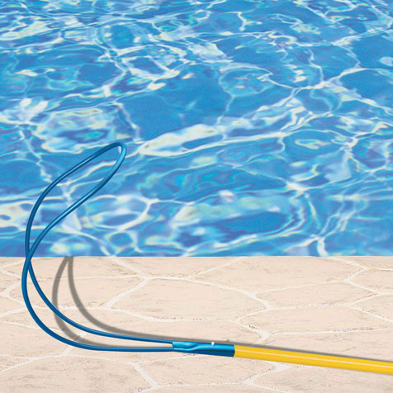
Life Pole
Required at Class A, B & C pools Must be visible from all areas of the pool
Light weight, strong, non-telescopic, 12 ft min and permanently attached
Fiberglass or non-conducting; body hook with blunted ends
1 pole/throwing rope/buoy for every 2000 ft2 of pool surface area
If more than 6000 ft2 of surface area, then an additional pole/throwing rope/buoy for each additional 4000 ft2

Slide 65
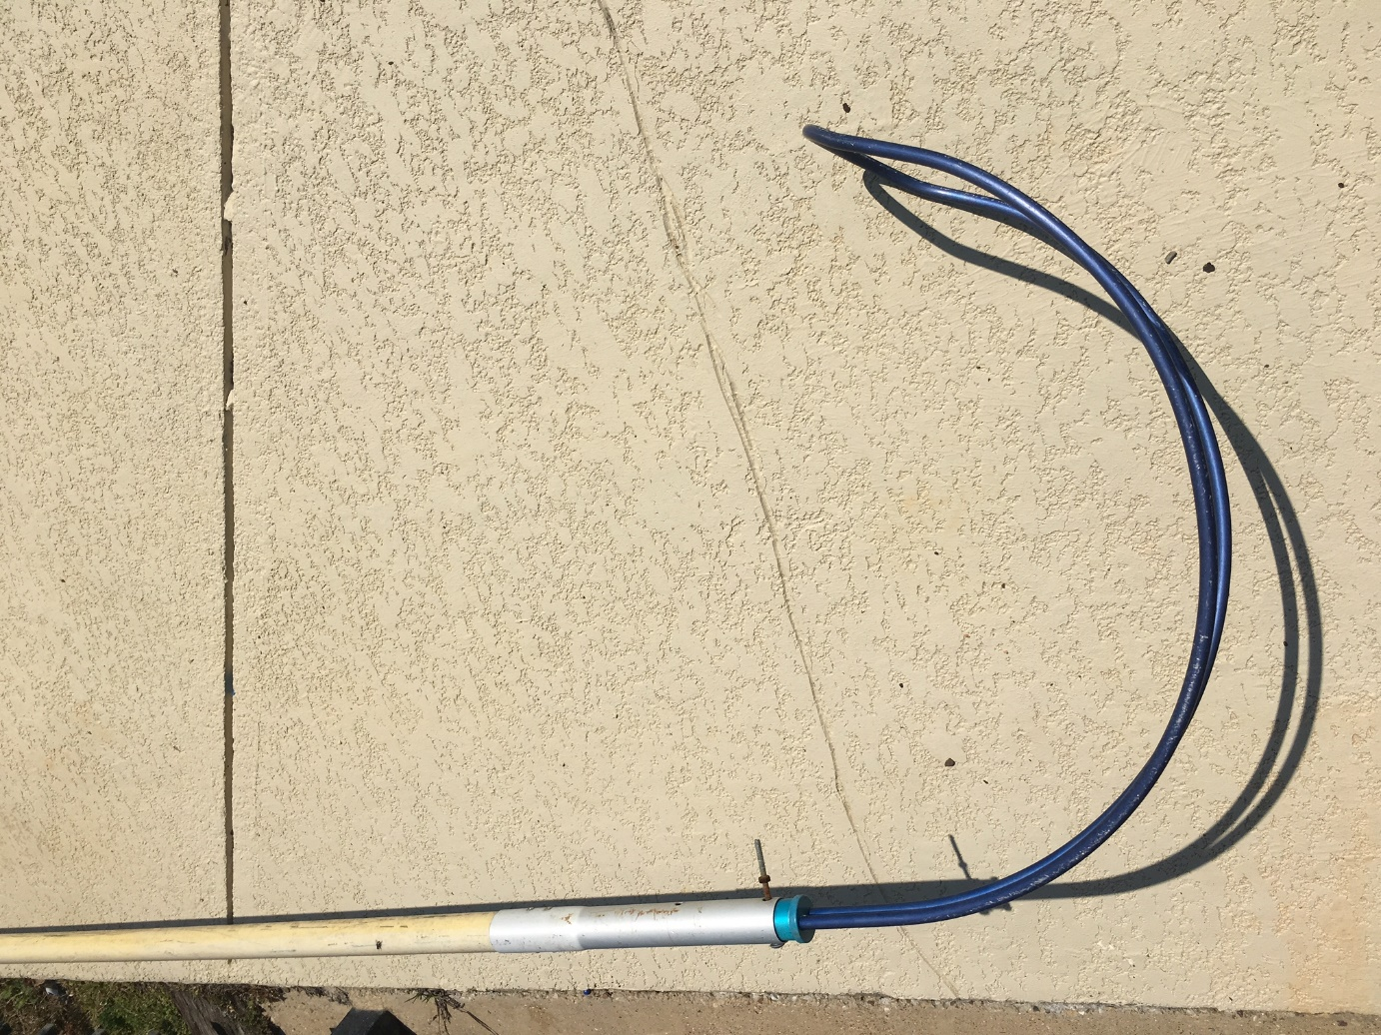
What is wrong with this life pole ?

Slide 66
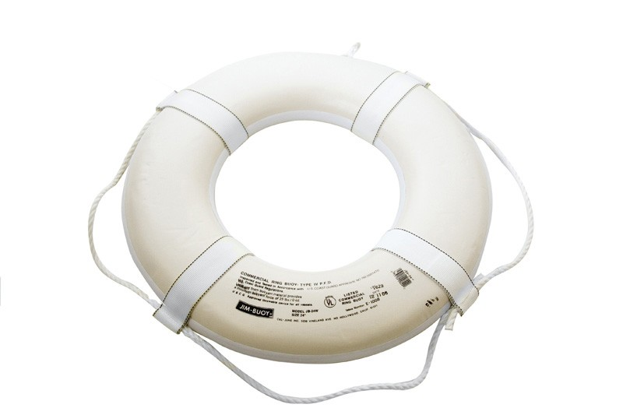
Ring Buoy
Required at Class A, B & C pools and visible/readily accessible from all areas of the pool yard
U.S. Coast Guard approved 15-24” diam.
Attached to a ¼ - 3/8 ” rope, 2/3 max pool width
1 pole/throwing rope/buoy for every 2000 ft2 of pool surface area
If more than 6000 ft2 of surface area, then an additional pole/throwing rope/buoy for each additional 4000 ft2

Slide 67
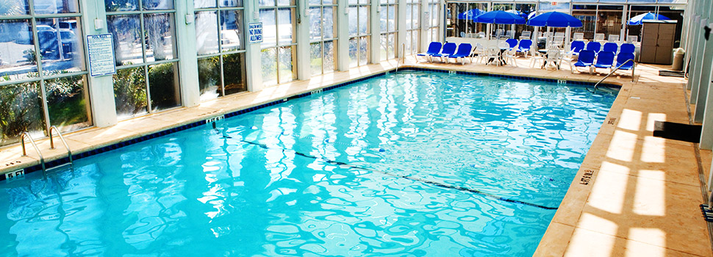

Dividing Line and “Toe Line”
*Both required at Class A & B pools, floor marking required at Class C
*Floats spaced 7 ft max apart
*Sufficient size and strength for handhold support
*Side wall attachments are corrosion resistant and non-projecting when rope is detached.
* Placed at pools over 5 ft depth, 1 to 2 ft on shallow side
*Floor Marking is 4” wide in contrasting color

Slide 68


Is THIS A contrasting Color?

Slide 69


Contrasting Tile Change

Slide 70



FIRST AID KIT and BACKBOARD
Required at Class A, B & others w / lifeguards. Standard OSHA 24 unit.

Slide 71

Spa Emergency Shutoff
Required for all spas, 5 ft or more away (except for air switches), in 1” letters, within sight of spa (or a sign stating the location of the switch).

Slide 72



Thermometer
A thermometer is
required at all spas.
Must be unbreakable type.
Max allowable temperature at spa is 104 degrees Fahrenheit.
Also, a visible clock is recommended near each spa.
CONSIDER A
SKIMMER LID
THERMOMETER

Slide 73


LIGHTING
Required if operated during low illumination: underwater (0.5 watts per ft² water surface); overhead (0.5 foot candles per deck surface) with no bottom glare. Also, GFI required.
(quick tip: if the light is floating in the pool - close the pool!)

Slide 75
Signage
The following signs are required at all pools and spas without a lifeguard
The following signs are to be mounted visibly and securely inside the pool closure
Additional sign for telephone location required outside for A, B & C pools on the gate, door or fence if locked.

Slide 76


Slide 77

Depth Markings
(All Pools and Spas)
Depth Markings:
4” PERMANENT LETTERS
SLIP-RESISTANT
CONTRASTING COLOR
IN FEET ON DECK
DEPTHS ARE MEASURED 3’ OUT FROM WALL
PLACED EVERY 25‘ OR LESS APART, FOR EVERY
2’ CHANGE OF DEPTH, AND ALSO AT 5’ DEPTH
WITHIN 24” FROM AND FACING WATER EDGE
AND 50% OF LETTERS ABOVE WATER LEVEL
MINIMUM OF 2 DEPTH MARKERS PER SPA

Slide 78

Bather Load Sign with
Calculation Chart
Pools: Letters are minimum of 2 inches in size
Spas: Letter are minimum of 1 inch in size

Slide 79


FENCES
Pool Type Fence Opening Height Gates (open outward)`
Class A, B 4” diameter sphere 6 ft Supervised or locked
Have no openings in the enclosure, either through or under it, which would allow passage of a 4-inch sphere and have no horizontal mid-rail and be designed and constructed so that it cannot be readily climbed.
*under Chap 757 4” diameter sphere 4 ft Self-closing, latching
Class C, D 4” diameter sphere 4 ft Self-closing, latching
Have no openings in the enclosure, either through or under it, which would allow passage of a 4-inch sphere and have no horizontal mid-rail and be designed and constructed so that it cannot be readily climbed. The distance between horizontal members of a fence that is 48 inches in height shall be no less than 45 inches.
Chain link only permitted for fences installed on or before 9-1-04 and may not be used for a post-10/1/99 pools. Pool and spa fences at pools and spas constructed before October 1, 1999, that replace the chain link fence are prohibited from using chain link fencing.

Slide 80
GATES
Gates and doors of the pool or spa enclosure shall:
Be equipped with self-closing and self-latching devices and are designed to close and keep the gate or door securely closed and latched at all times the gate or door is not in use
Open outward away from the pool or spa
Have hand activated door or gate opening hardware located at least 3-1/2 feet above the deck or walkway. Pools and spas constructed, or pool/spa enclosure and gates renovated on or after the effective date of this subchapter shall have the gate opening hardware only on the pool/spa side of the gate and the gate and enclosure shall have no openings greater than 1/2 inch within 18 inches of the door or gate opening hardware
Be capable of being locked and be locked if the pool or spa is not open for use
Be locked if the pool or spa is closed for repairs, hazards, weather related hazards, adding chemicals by hand, or any other condition that warrants closure of the pool or spa

Slide 81


Ladders
Ladders constructed or renovated on or after 1 January 2021 shall be constructed of corrosion resistant materials and shall be anchored securely to the deck and bonded in accordance with the NEC. Ladders in pools and spas shall comply with the following:
(1) Two handrails shall be provided for each ladder, one on each side of the ladder with a clear distance between ladder handrails of not less than 17 inches and not greater than 24 inches.
(2) Ladder treads shall have a uniform horizontal depth of not less than 2 inches. There shall be a uniform distance between ladder treads not less than 7 inches and not greater than 12 inches, and ladder treads shall be slip-resistant.
(3) The top tread of a ladder shall be located not greater than 12 inches below the top of the deck or coping.
(4) Wall clearance between the pool or spa wall and the ladder shall be not less than 3 inches and not greater than 6 inches.

Slide 82
Handrails
A handrail shall be provided in pools and spas for which a lifeguard is required or provided under this subchapter. When provided in pools and spas, handrails shall comply with the following:
(A) Handrails, if removable, shall be installed in such a way that they cannot be removed without the use of tools.
(B) Handrails shall be constructed of corrosion-resistant materials.
(C) Handrails for use by persons with disabilities shall comply with applicable federal, state and local requirements for access by persons with disabilities.

Slide 83
Handrails
In pools and spas constructed or renovated after 1 January 2021, handrails shall meet the following requirements:
(A) The top of the gripping surface of handrails shall be 34 inches to 38 inches above the ramp or step surface as measured at the nosing of the step or finished surface of the slope.
(B) The leading edge of handrails for stairs, pool entries and exits shall be located not greater than 18 inches from the vertical face of the bottom riser.
(C) The outside diameter or width of handrails shall be not less than 1-1/4 inches and not greater than 2 inches.
(D) Handrails for use by persons with disabilities shall comply with applicable federal, state and local requirements for access by persons with disabilities.

Slide 84
Chemical Storage
Follow chemical manufacturer's stacking procedures and storage guidelines
Keep the chemical storage area clean
Inspect chemical containers regularly
Use chemicals on a first in, first out basis
Wear appropriate protective gear when handling chemicals (eye, skin, and respiratory protection)

Slide 85



!!!WARNING!!!
If you are responsible for maintaining an outdoor pool….This is for your safety and every one of your pool users. DO NOT MIX stabilized and un-stabilized chlorine, they should not be stored near each other. The reaction of an isocyanurate with hypochlorite can result in rapid formation of nitrogen trichloride, which at high enough concentrations will detonate spontaneously with great violence.

Slide 86


Safety Data Sheets (SDS)
Shall be maintained for every chemical used and available for emergency responders upon request
Storage (be careful how and where you store your chems)
Labeling
Protective Equipment for Operators – “THAT’S YOU!”
Safety
First Aid and Treatment

Slide 87

NO MANUAL FEEDING
The water that builds up in the skimmer can become very acidic, forcing corrosive water back through the system.
It is also a health hazard for people swimming in front of the skimmer, especially children.
Notes:
No manual feeding of pools, this can be hazardous to children if they reach in to retrieve the tablets. I is also creates a very caustic dose that will help corrode the system.

Slide 88

Be careful when opening skimmer lids

Slide 89


DPD TEST KIT
The most reliable piece of equipment for pool operators is
A DPD TEST KIT
Taylor K 2005
For Bromine/Chlorine Pools
Taylor K 2006
For Chlorine Pools
If using for Bromine Pools, you need to
Calculate 0.2 X drops and then X 2.25
For total Bromine…you don’t check for
Combined Chlorine with Bromine Pools
Notes:
Your DPD test kit needs to be accurate to the nearest 0.2 ppm

Slide 90
Water Testing
Keep kits and chemicals:
Protected
Out of direct sunlight
Out of high temperatures
Off of the floor
In a cabinet or on a pallet
Kits should be replaced yearly

Slide 91
Test Kits
Do not interchange bottle caps on reagents
Replace reagents as necessary-exp. dates
Replace Cloudy comparators and/or sample tubes ….
All the above can lead to inaccurate readings!

Slide 92

How to Test
Take samples at elbow depth well away from return lines (about 18 inches below water surface)
Wipe the reagent tip with a clean, damp cloth or paper towel to eliminate static electricity which may interfere with drop size.

Slide 93
How to Test
When adding titrant, gently swirl the sample tube to mix reagent completely into water.
If colorimetric test are used, hold comparator up to sunlight.
After the addition of any chemicals, wait one complete filter cycle before testing again.

Slide 94
False Readings
If you observe a zero chlorine result, follow your test kit’s recommendations. For example:
  If a temporary pink color appears, the sample has a high chlorine content, and dilution is necessary to achieve accurate results.
A false reading may be obtained with pH, when high levels of chlorine or bromine are in sample:
  If you observe a dark purple color follow the test kit’s recommendations: You may have to add sodium thiosulfate to neutralize the chlorine.
The presence of high levels of chlorine will oxidize one of the two total alkalinity color indicator reagents in the sample. If this occurs, follow the test kit’s recommendations:
  Usually involves repeating test with the addition of sodium thiosulfate
Notes:
A false DPD reading may develop with a high chlorine concentration or high pH in the water sample. Another false free chlorine reading can be obtained when the combined chlorine is too high—especially if the potable water is from a municipal system that used combined chlorine as the disinfection.

Slide 95
Documentation Needed onsite
What’s being done currently?
Water Testing Logs
Equipment Manuals
What’s required?
Test Logs
Mechanical Equipment Records
Know the local Codes

Slide 96
Water Testing Logs
Records of all testing of the pool and spa water shall be maintained at least 2 years and be available or made available upon request by the department or local regulatory authority. Records of testing can be kept on-site or off-site. If records are stored off-site they must be provided within 5 business days.

Slide 97
If possible, use waterproof records

Slide 98


Slide 99

FORMULAS FOR DIFFERENT SHAPES
Different Area Shapes

Slide 100

Circulation
Pool Sizing
Determine Average Pool Depth
Deep end depth (ft)__+ shallow end depth (ft)__ ÷ 2 = Avg. Depth (ft)__
Determine Pool Volume
Rectangular Pools:
Length __ X Width __ X Avg. Depth __ X 7.5 = __ Gal.
Round Pools:
Long Dia. (ft)__ X Short Dia. (ft)__ X Avg. Depth__ X 5.9 = __Gal.
*Example on the next slide*
Notes:
Knowing the volume of water in any aquatic feature is critical for the proper management of operating equipment, chemical dosing, and patron use. The main difference between a swimming pool and a natural body of water is the circulation system. Without movement of water, undesirable growth of algae and pathogens can occur rapidly.

Slide 101

32 feet
2 feet
16 feet
10 feet
SURFACE AREA
AVERAGE DEPTH
7.5
(2 + 10) / 2 = 6.0 AVERAGE DEPTH
6.0 X 16 X 32 X 7.5 = 23,040 GALLONS

Slide 102
Circulation Turnover Rates
Spa - 1/2 hour
Wading – 1 hour
Post 10/1/99 pool < 4ft avg. depth (x 1.5) – 4.5 hours
Post 10/1/99 pool > or = 4ft avg. depth – 6 hours
Pre 10/1/99 pool (heavy bather load) – 6 hours
Pre 10/1/99 pool (normal load) – 8 hours
NOTE: Generally, wading pools, spas, and heavier loads require faster turnover rates since more organic substances such as sweat, urine, feces, skin, etc. are expected to be present.
Notes:
Swimming pools-6 hours
Spas- 30 min
Wading pools – 1 to 2 hours
Waterparks/specialty pools – 3 to 4 hours
Hospital/health club pools – as low as 3 hours
Turnover rate is the time it takes for the circulation system to move the number of gallons equal to the volume of water in the pool through the filtration equipment. Water is processed through the filter, chemically treated, and then returned to the pool. In the pool, filtered water is diluted with the unfiltered water. Continuous removal of pollutants occurs by the process of partial dilution

Slide 103


Does this look installed CORRECTLY?

Slide 104

Circulation
Correct Installation of a Flowmeter
1. Match Flowmeter with pipe size and flow direction arrow.
2. Flowmeter shall read at least 1-1/2 times design flow rate.
3. Install flowmeter on the return pipe after other system components, but before any chemical feeders.
4. Install it on a straight pipe at a minimum distance from all elbows, tees, or reducers using the following rule:
(10 times the pipe diameter upstream and 4 times downstream to avoid flowmeter inaccuracies due to internal turbulence.)

Slide 105


Circulation
Flowmeters & Turnover rates
How to Calculate the Flowmeter Reading for Turnover Rate:
Pool Volume = How Many Gallons Per Minute X 60 will tell you how many gallons are running through your system per hour. Divide that by the pool volume and you will get your turnover rate.
Example: 1,000 gallon wading pool. Shows a flowmeter reading of 17gpm. X 60 minutes.
17.00 Gallons Per Minute X 60 =1,020 gallons per hour
17.00 X 60 = 1020
Or 1 hour of time
Notes:
All public pools and spas should be equipped with a flow measuring device that indicated the rate of flow through the circulation system. The flow meter usually reads in gallons per minute. The rate of flow indicator should be properly sized for the design flow rate and must be capable of measuring ½ to at least 1 ½ times the design flow rate. The flow meter is generally mounted on the return piping after all other system components but before any chemical feed injection.

Slide 106

Circulation
When Flowmeter Readings are too Low
Filter clogged, backwashing may be necessary
Skimmers, screens, strainers may need cleaning
Flowmeter itself may need cleaning. It may also be installed incorrectly.
Pump malfunction

Slide 107


Conditions Resulting in Possible Closure
Main Drain Covers or Grates non-compliant, missing, broken, or loose.
Inadequate Disinfectant Level.
Presence of Fecal Matter from humans or animals.
Water Clarity- Bottom and Main Drain are not clearly visible in the deepest part of the pool or spa.
No Operating Permit
Emergency 911 phone inoperable.

Slide 108


What to do at the end of the season……
For pools not in use for extended periods of time, clarity should be maintained, algae growth prevented, and no objectionable odors, insect breeding conditions, or other nuisance or safety hazard shall be present.
Pump not operating continually- it may operate less than 24 hours/day if a pool closed sign is installed on every gate and clarity and disinfectant are maintained.

Slide 109

When to Backwash
1. Follow the manufacturer’s instructions.
2. If instructions are not available, backwash when the pressure between the inlet and the outlet of the filter is 10 to 12 psi., as follows:
Filter with 1 Pressure Gauge: First backwash completely and record the cleaned filter pressure; this is the reference pressure for a clean filter. Later, when the gauge measures 10 to 12 psi above the reference pressure, then backwashing is necessary.
Filter with 2 Pressure Gauges: Backwash when the difference between the 2 gauges measures 10 to 12 psi.

Slide 110

When to Backwash continued
3. Note: Backwashing should not be done too frequently since freshly backwashed filters are not very efficient. However, efficiency increases as the pressure nears 10 to 12 psi.
4. Flowmeter reading may be reduced noticeably when filter begins to clog.
5. Instructions for backwashing, filtration, cleaning, operation, and general maintenance shall be available.

Slide 111

So, What Do Filters Remove?

Slide 112




The Micro-Filtration Process by size.
* Note: pathogens cannot be filtered out of a pool *
* Remember that the best filter (D.E.) can only remove something up to 4 Microns µm *
Giardia 8 – 15 µm microns | Cryptosporidium 3 – 5 µm microns | Human strand of hair 20 to 100 µm microns | E. Coli 0.2 µm microns

Slide 113


Sand Filter
Sand must be backwashed to clean
the sand media.

Slide 114
Channeling and mudball formation
On a seasonal or yearly basis, clean the sand inside the filter tank by adding a commercial sand cleaning solution or sodium bisulfate.
Channels which form inside the sand should be destroyed.
Mud balls
BOTH
Manufacturers recommend: that the top 6 inches of sand be removed and replaced with fresh #20 silica on a yearly basis.

Slide 115


Cartridge Filter
Not backwashed -- cartridges are removed and cleaned manually.
Once cleaned, cartridges never recover their entire surface -- they lose:
25-35% of their filtering capacity after each cleaning
Cartridges have a limited lifespan -- occasional replacement is required

Slide 116


D.E (diatomaceous earth)
Information on next slide
Notes:
recoat
new grid/leave canvas

Slide 117


Diatomaceous Earth Filters
Single tank
Pressure, vacuum or regenerative systems.
D.E. - Fossilized skeletal remains of single celled sea plants (diatoms), mined and refined.
Respiratory protection required when handling D.E.
Contains amorphous (non crystalline) D.E. and crystalline silica
Grid support (metal or plastic)
Septa (usually woven synthetic fabric) that D.E. is deposited on

Slide 118

Maintenance Work
Notes:
Welcome!
About Me: Supervisor (One Man Band), TPPC/conference Attendee, Recognize Need

Slide 119

Daily Maintenance
Typical Items
Water Testing
Vacuuming
Skimmer Baskets
Cleaning Surfaces (benches, tables, furniture, etc.)
Maintain Deck, Storage, and Pump Room Cleanliness
Items Overlooked
Cleaning Vacuum Filter(s)
Ladders, Steps, Lift Operational
Checking/Tightening Inlet/Outlet Covers

Slide 120
Year-Around Maintenance
Typical Items
Backwashing (when needed)
Cleaning Tile/Scum Line
Cleaning/Hosing Pool Decks
Disinfecting Surfaces
Cleaning Stainless Steel
Items Overlooked
Chemical Inventory
Strainer Baskets
Disinfecting Door Handles, Furniture, Lockers, Benches
Disinfecting Rescue Equipment

Slide 121


Staff Training
Orientations
Mentoring

Slide 122

What goes into a facility tour?
Pools & Decks
Pool Equipment
Pump Room
Bathrooms
SDS Books
Cleaning & Storage Closets
Chemical Equipment & Storage
Cleaning Equipment & Their Use
Notes:
This is Unique to Maintenance needs.

Slide 123



Practical experience is important for:
Water Testing
Pressure Washing
Sweeping & Hosing Decks
Cleaning Bathrooms
Vacuuming the Pool
Pump Room Maintenance
Backwashing/Cleaning Filters
Cleaning Tiles, Surfaces, & Stainless
Notes:
This is Unique to Maintenance needs.

Slide 124
Number of Lawsuits Increasing & Awards Soaring, why?
Number of facilities is increasing
Aging of facilities, & lack of preventative maintenance
Number of attorneys
Participation increasing
More risky activities
Cost of insurance/lack of insurance
Rising medical costs

Slide 125
Common Reasons for Aquatic Lawsuits
Inadequate supervision
Inadequate, inaccessible or improperly maintained rescue equipment
Lack of qualifications, certification, training
Inadequate facility maintenance
Signage that does not provide meaningful warning
Failure to prohibit swimming under dangerous conditions (Thunder Storms)
Unsafe handling, storage, or dispensing of chemicals

Slide 126
To Reduce Liability Exposure
Inspect the premises & perform regular safety audits
Notify your supervisor in writing of hazards
Properly supervise participants
Maintain the facility and equipment
Keep accurate and thorough records
Strictly comply with codes/rules
Post signs and warnings
Enforce rules

Slide 128
Test review questions
2022

Slide 129
1.What is the maximum level allowed for Combined Chlorine in a pool or spa ?

Slide 130

Answer 1: The maximum allowable level is
0.4 ppm

Slide 131
2. How long are operational
records required by the State Code to
be available on site?

Slide 132

Answer 2: Records of all testing of the pool and spa water shall be maintained at least 2 years and be available or made available upon request by the department or local regulatory authority. Records of testing can be kept on-site or off-site. If records are stored off-site they must be provided within 5 business days.

Slide 133
3. Should you pour chemicals into a bucket with water, or pour water into a bucket with chemicals already in it?

Slide 134



Answer 3: Always pour chemicals into the water, not water into chemicals.
Some acids heat up extremely fast,
that could cause splatting as well as giving off a concentrated toxic gas.

Slide 135
4. What type of pool can only use cyanuric acid? indoor or outdoor pools?

Slide 136

Answer 4: Cyanuric Acid ...also known as (Stabilizer, CYA, Conditioner) can only be used for outdoor pools. It is designed to block Ultraviolet rays from breaking down free chlorine.
“Only-outdoor pools/spas”

Slide 137
5. How often are you required to test the chemical levels in your pool?
Once a week?
Every other day?
Once a day?
Four times a day?

Slide 138

Answer 5: When Class A and Class B pools and spas are open, they shall be tested for disinfectant levels, and pH every 2 hours. If a system is used to automatically control disinfectant and pH, testing for disinfectant level and pH shall be made at least once per day and a reading of the automatic control device shall also be made. Cyanuric acid levels shall be measured once each week.

Slide 139
Answer 5: Class C pools and spas that have on-site staff primarily responsible for pool and spa operations, such as lifeguards, shall be tested for disinfectant levels and pH a minimum of 3 times a day. If a system is used to automatically control disinfectant and pH, testing for disinfectant level and pH shall be made once a day and a reading of the automatic control device shall also be made. Cyanuric acid levels shall be measured once per week.

Slide 140
Answer 5: Class C pools and spas that do not have on-site staff primarily responsible for pool and spa operations, such as lifeguards, shall be tested for disinfectant levels and pH a minimum of one time a day. If a system is used to control disinfectant and pH electronically, and the system has the ability to transmit the mV level, or free chlorine level and pH to the trained and certified operator once a day, sanitizer level and pH shall be measured once a week using a test kit. A reading of the automatic control device shall also be recorded. Cyanuric acid levels shall also be measured once per week.

Slide 141
True of False?
6: A strong chlorine smell means
there is a lot of chlorine in the pool still?

Slide 142

Answer 6: False…You are smelling chloramines…these are the by-products of chlorine binding with sweat, urine, and others wastes from swimmers.
“FALSE”

Slide 143
True or False?
7: The best place to take a
water sample is from the
water surface level of the pool?

Slide 144

Answer 7: False
Water samples need to be
taken at least 18 inches
below the surface level and at
transitional points.

Slide 145
True or False?
8: Is it ok to put chlorine
tablets into skimmers to
help maintain chlorine levels?

Slide 146

Answer 8: False
The water that builds up in the skimmer can become
very acidic , forcing corrosive water back through the system.
It is also a health hazard for people swimming in front of the skimmer, especially children.
NO MANUAL FEEDING

Slide 147
True or False?
9: Test reagents should not be kept longer than a year and should be kept out of direct sunlight and heat?

Slide 148


Answer 9: TRUE
Reagents should be changed each year and removed from direct sunlight and heat.

Slide 149
Question 10: Is vacuuming recommended in an accidental fecal response procedure?

Slide 150
Answer 10:
No. Per CDC guidance, vacuuming is not recommended.
1. Raise free available chlorine level to 20 ppm
2. Maintain pH between 7.2 – 7.5
3. Maintain chlorine level for 12 hours
4. Operate filtration system the entire disinfection time
5. Backwash filter after the full disinfection time-direct to waste and not back into pool
6. Return chlorine level to normal
7. Log the event and record the date, AFR type, and the chlorine level at time of event.

Slide 151
Question 11:
How long should someone wait to enter a pool or spa after experiencing diarhhea?

Slide 152
Answer 11:
Do NOT enter the pool or spa for TWO WEEKS after having diarrhea.

Slide 153
Question 12:
What is the maximum temperature in Fahrenheit that a spa can be?

Slide 154

Answer 12:

Slide 155
Question 13:
Should you mix stabilized and un-stabilized chlorine and should they should stored near each other?

Slide 156

Answer 13:
DO NOT MIX stabilized and un-stabilized chlorine, they should not be stored near each other.

Slide 157
Question 14:
How would you best describe “water clarity?”

Slide 158
Answer 14:
Water clarity shall be sufficient such that an eight-inch black disk on the floor at the deepest part of the pool can be clearly and immediately seen by an observer on the water surface above the disk or by someone standing on the deck closest to the disk.

Slide 159
Question 15:
How should pools be kept when not in use for extended periods of time?

Slide 160
Answer 15:
For pools not in use for extended periods of time, clarity should be maintained, algae growth prevented, and no objectionable odors, insect breeding conditions, or other nuisance or safety hazard shall be present.

Slide 161

Please do not leave without your Training Certificate
Any final questions?
Dak Prescott #4

Slide 162
GUIDANCE
REMEMBER-all requirements are taken from the:
TAC or “Texas Administrative Code” TITLE 25 Part I Chapter 265 Subchapter L – Standards for Public Pools and Spas §265.181-§265.208
Go to www.dshs.state.tx.us

