Slide 1
NET Health Food Safety Round Table Meeting
July 8, 2019

Slide 2
Thank you for your attendance!!
With our coordinated effort to make food safety a priority, we can achieve our objective of making our community one of the healthiest communities in the State of Texas.

Slide 3
Topics For Discussion Today
Discussion of Any Food Safety Concerns Experienced in Past Quarter (15 Min.)
Food Truck Risk Factors and Public Health Intervention Violation in Suffolk County NY(15 min)
Topics of interest effecting each area (60 Min)
State Legislative Activities
HB 234
HB 410
HB 1694
HB 2107
HB 2755
SB 476
SB 572
SB 932
Q&A (30 min)

Slide 4
Local Food Safety Threats?
What is going on in your area that you see as a food safety risk to our public?
Topics for consideration at next meeting?

Slide 5
AFDO.org Association of Food and Drug Officials

Slide 6
Food Truck Risk Factors & Public Health Intervention Violations in Suffolk County, New York

Slide 10
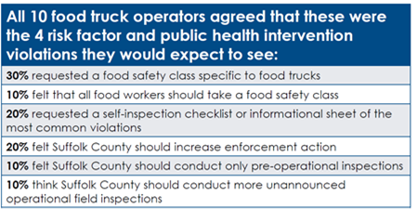
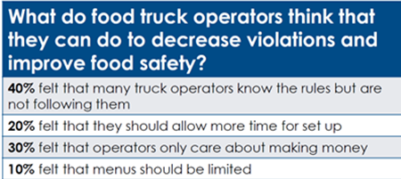

Slide 13
86th Legislative Bills - Passed
All bills are effective September 1, 2019
Bill Subject Matter
Cottage Food
Limitation of food regulation at farmers market and cottage food production operations
Child Lemonade Stands
Personal Use Exemption – Rabbit Meat
Information provided by local health jurisdiction
Amount of certain fees in county and Health District
Dogs in outdoor dining area of food establishments

Slide 14
Cottage Food Production
SB 572 – allows pickled vegetables, fermented products (department approval) & canned goods

Slide 15
Farmer’s Market
HB 1694 – no permit, fees or provisions for samples at FM’s by local government
HB 2107 – Reasonable response <= 30 days from local jurisdiction to Farmers/food producers
SB 932 – Cap of $50 permit

Slide 16
Farmer’s Market – HB 1694
No permit, fees or provisions for samples at FM’s by local government
TX Health & Safety Code 437.020 (a)
A product made from a product described by this subdivision by a farmer or other producer, including a cottage food production operation, who grew or processed the product; or produce.
Health Department may not
Require permits to provide samples
Regulate the provision of samples of food
Health Department may
Perform inspection to enforce TX H&S 437.020(a)
Permit food cooked at farmer’s market

Slide 17
HB 1694 continued
No one adopts a rule requiring a farmer’s market to pay a permit fee for:
Cooking demonstrations
Bona fide educational purpose
Providing samples of food

Slide 18
Request For Determination HB 2107
Subchapter H, Chapter 438 H&S code
Included local health jurisdiction along with department
Limit of maximum of 30 days for written response after receipt of written request regarding applicability of regulation or requirement for compliance
Written “official” determination is valid until regulation is amended.

Slide 19
Farmer’s Market - SB 932
Chapter 437, H&S Code
Section 1, defines farmer’s market &
Permits issued for
Farmer selling to consumers at F.M, Farm Stand & Farm
Individual preparing food for sale at F.M.
Permits issued to the farmer or individual
Valid no less than 1 year
Cap fee at $100
Location: unrestricted at F.M.’s, Farm Stand & Farm throughout jurisdiction

Slide 20
SB 932 - continued
Section 2, includes 437.0065
No regulation of samples
Section 3
Local health department may issue permit to a person who sells food at a farmer’s market subject to 437.0065
Section 4. Section 437.0201 (c) repealed

Slide 21
Lemonade Stands
HB 234 – prohibits local jurisdiction from prohibiting sale of non alcoholic beverages by children < 18yrs on private property
No permits, fees, or license
All beverages that are non-alcohol & Non TCS
Location: A stand on private property or in a public park
HOA or POA can’t prohibit or regulate

Slide 22
Low-Volume Livestock Processing Establishments
HB 410 – Exempts DSHS registration & Sanitary OPs of fewer than 500 rabbits in one year
Companion Bill that did not come pass legislature
SB 1341 – low volume – livestock processing establishment. >1000 & < 20,000 per year by operator. No additional state regulation & can sell to consumers/restaurants

Slide 23
Low-Volume Livestock Processing Establishments
Rabbits. Yearly limits
< 500
Exempt from Federal Inspection & Registration
No Required Standard Operation Procedures Plan
< 10,000 rabbits
Poultry.
>1000 but fewer than 10,000 poultry
Not subject to additional state regulation
May sell directly to Consumers

Slide 24
Food Establishments/Permits
SB 476 – Pets on Patio. Companion to HB 1801 – no local rule more stringent than this.
A food service establishment may permit a sustomer to be accompanied by a dog in an outdoor dining area if:
Posts sign visible stating dogs are permitted
Access to area directly from exterior
Dog does not enter establishment
Kept on leash and in control, no sitting on seat, table
No food is prepared and no open food other than food that is being served to customer

Slide 25
Food Establishments/Permits
HB 2755 – removes cap on permit fees for public health districts
Removes restriction of fee cap to recover cost of services.

Slide 26
Next Meeting
October 8, 2019 Tuesday - 2:30PM
Tyler Chamber of Commerce - Genecov

